Slide 1
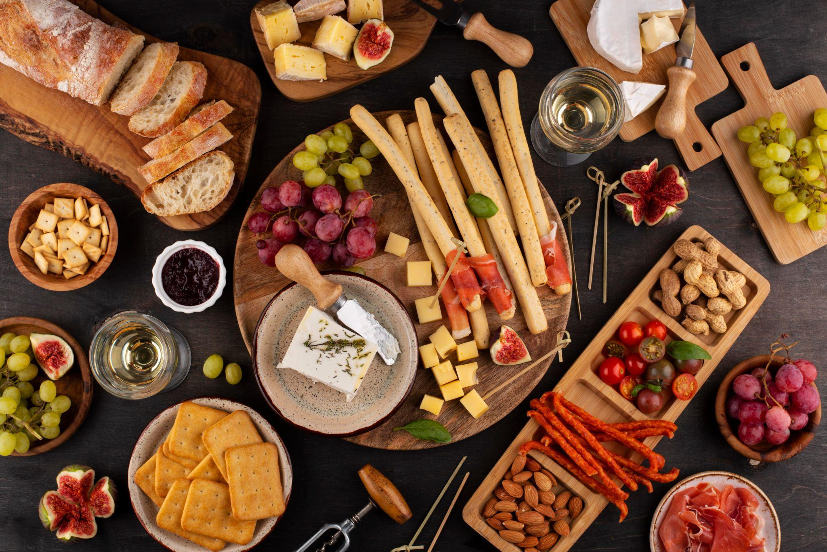
Presented by Daniel Berbari Jean-Michel Barakat
Smart Fridge
Year: Fall 2025

Slide 2
Outline:
Introduction
The Smart Fridge Solution
How it Work
Hardware & Price
Why it Matters Globally & SDG
Technical Overview
Future Add-ons
Conclusion

Slide 3
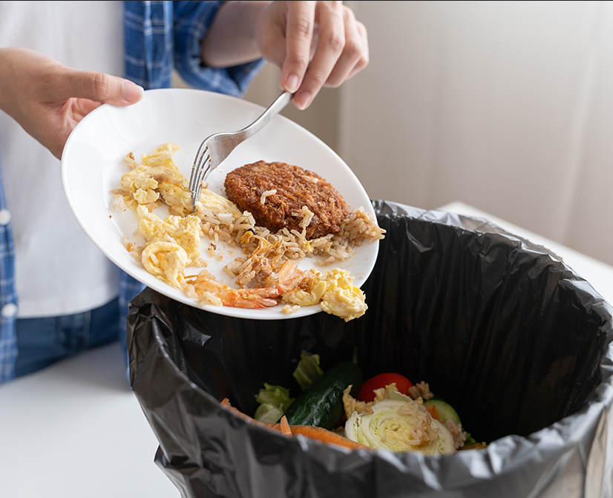
Traditional fridges cannot offer any smart features, only keeping food cold. Users have to remember each food stored inside the fridge and their expiration date This increases the risk of forgetting stored food. This leads to greater chances of food waste and frequently occurring food waste.
Introduction:

Slide 4
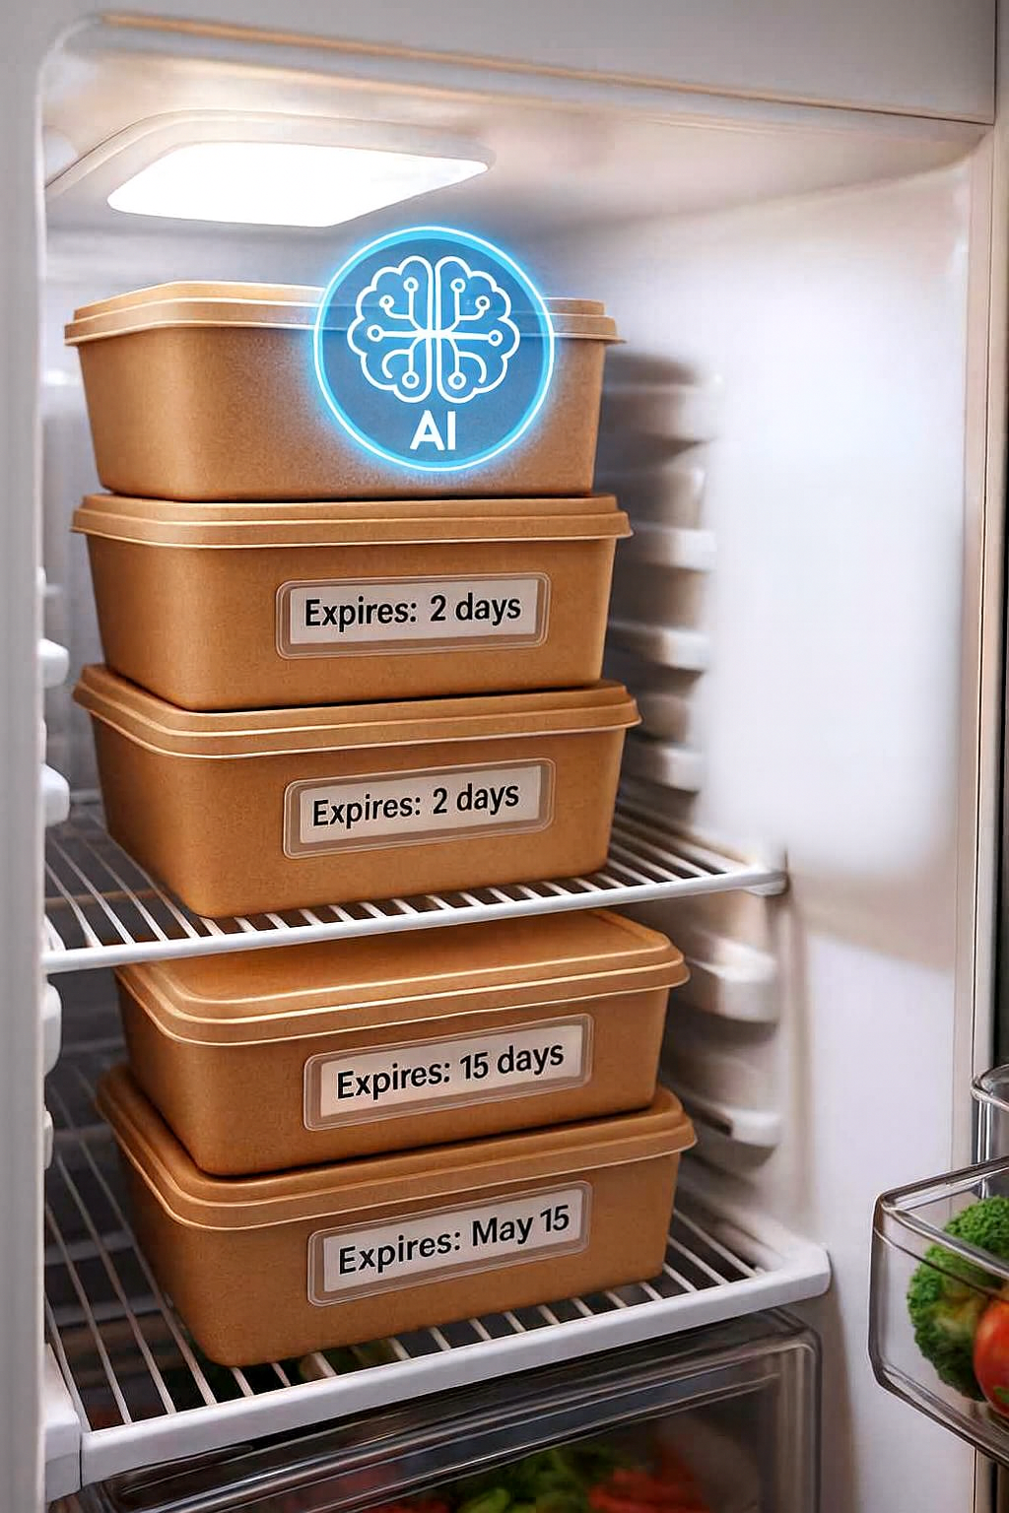
The Smart Fridge Solution:
A small device that can be installed on any existing fridge
Users input the foods by name or camera, and they are stored in the database
Expiration dates are automatically calculated depending on the food, or they can be given by the user
A user-friendly interface showing the food name, expiration date and location.
Sends reminders and alerts for items that are getting old or close to expiration.
Helps reduce food waste by giving recipe suggestions and prioritizing items that should be used soon.

Slide 5
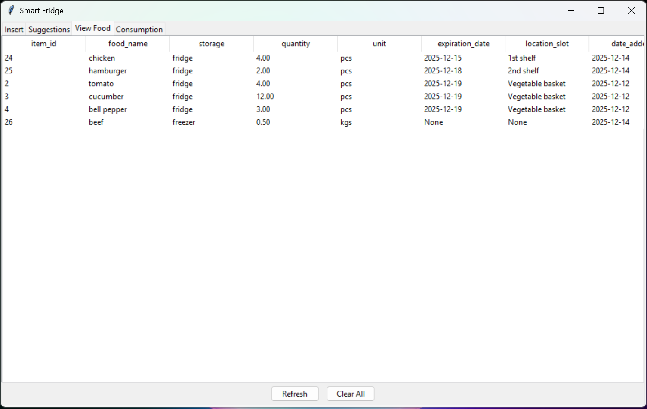
View food

Slide 6
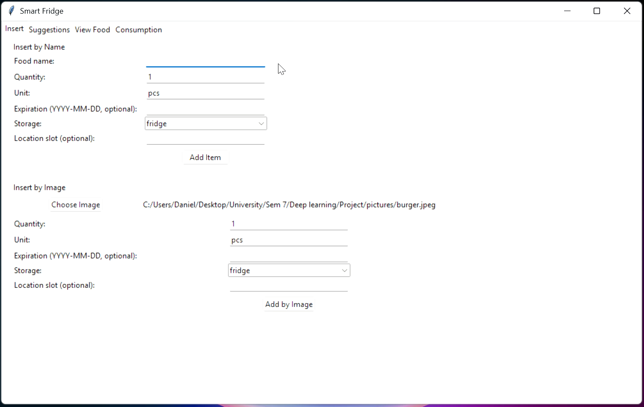
Food Insertion

Slide 7
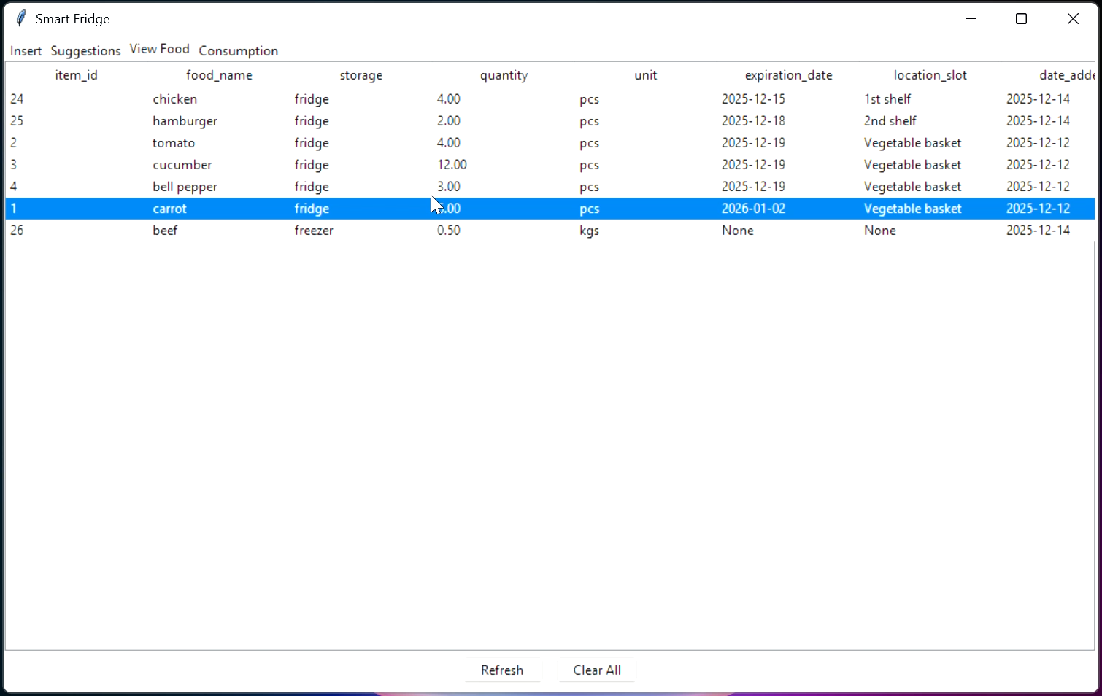
Food Consumption

Slide 8
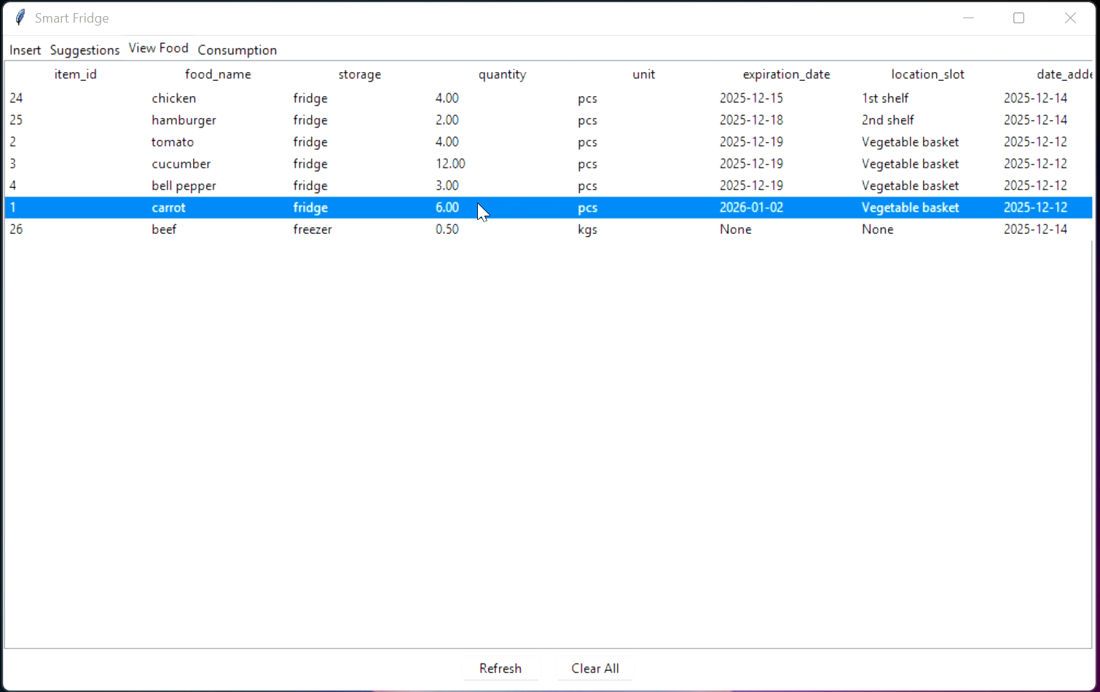
Recipe Generation

Slide 9
Hardware & Price
Components: High performance processor (Raspberry pi 5) HD camera for food recognition Compact 5″ Touch Screen Monitor Enclosure and power system
Target retail price: ~$199
Notes:
Raspberry Pi 5 (4GB) 70$
Camera Module (Logitech C270) 20$
ELECROW 5″ Touch Screen Monitor 40$
Power & Enclosure 15$
Total: 150$

Slide 10

Why it Matters Globally & SDG:
Reduces food waste
Responsible consumption
Lower carbon footprint
Notes:
Reduces food waste
Tracks stored items and expiration dates, helping households consume food before it spoils.
Supports responsible consumption (UN SDG 12)
Encourages smarter shopping, storage, and meal planning through real-time inventory awareness.
Lower carbon footprint
Food waste reduction directly cuts greenhouse gas emissions from production and disposal.

Slide 11
Technical Overview

Slide 12
Database:
Central storage for all fridge data
Stores:
Food items (name, quantity, storage: fridge/freezer)
Food categories and expiration dates
Enables:
Expiration tracking
Provides item and expiration data used in AI prompts

Slide 13
Automatic Categorization & Shelf-Life Estimation:
When an item is added:
System assigns a food category automatically
Shelf life is estimated based on food type
Uses:
Predefined food rules (e.g., dairy vs vegetables)
Storage location (fridge vs freezer)
Purpose:
Reduce food waste
Enable expiration-aware decisions

Slide 14
Food detection model
Model: EfficientNet-B2 (CNN)
Task: Detects the food type only from an image
Why EfficientNet:
Pretrained on large-scale ImageNet data
High accuracy with relatively low computation
Used as:
Visual input module for the smart fridge system

Slide 15
Training Process & Optimization
Training method: Transfer learning
Model initialized with pretrained weights
Custom classifier trained for fridge-relevant foods
Two-stage training:
Train classifier head while freezing feature layers
Fine-tune the full network with a lower learning rate
Robustness techniques:
Data augmentation (crop, rotation, color variation)
MixUp and label smoothing to improve generalization
Training control:
Validation-based early stopping
Test-time augmentation for more stable predictions

Slide 16
Gemini LLM
Gemini is used for:
Recipe generation
Smart suggestions based on available items
Prioritizing foods close to expiration
Takes into account:
Current fridge + freezer inventory
Makes the system interactive and intelligent

Slide 17
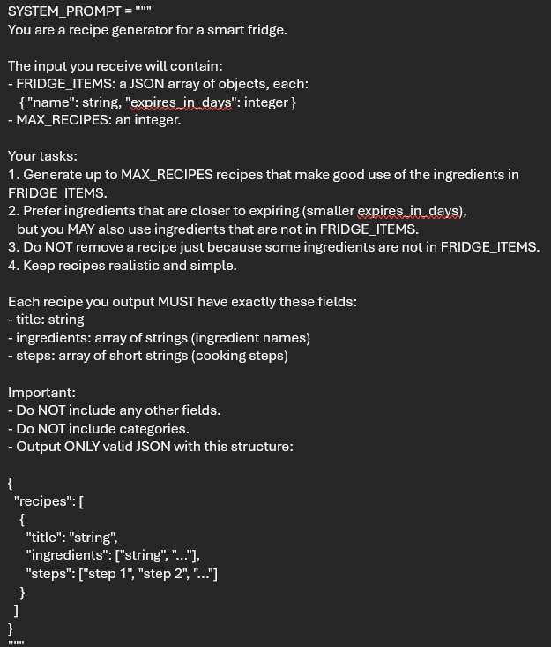
Recipe Generation
Backend sends structured data to Gemini:
Food items and Expiration dates
Uses API-based communication
Receives Text-based recipe suggestions
Displays the available and missing ingredients
Sorts the recipes by urgency score

Slide 18
Future additions
Personalized user preferences (likes, dislikes, dietary habits)
Multi-user support for shared households
Mobile application for remote fridge monitoring
Image-based food quantity estimation
Smart grocery list suggestions (food items only)
Pantry inventory integration

Slide 19
Conclusion
Notes:
The Smart Fridge system demonstrates how computer vision and intelligent software can be applied to everyday household problems.
By automating food tracking, monitoring expiration dates, and suggesting recipes, the system helps reduce food waste and improve user convenience.
The project is scalable and extensible, allowing future features such as personalization, multi-user support, and mobile integration.
Overall, this solution shows strong potential as a practical, sustainable, and market-ready smart home product.

Slide 20
Github repo

Slide 21
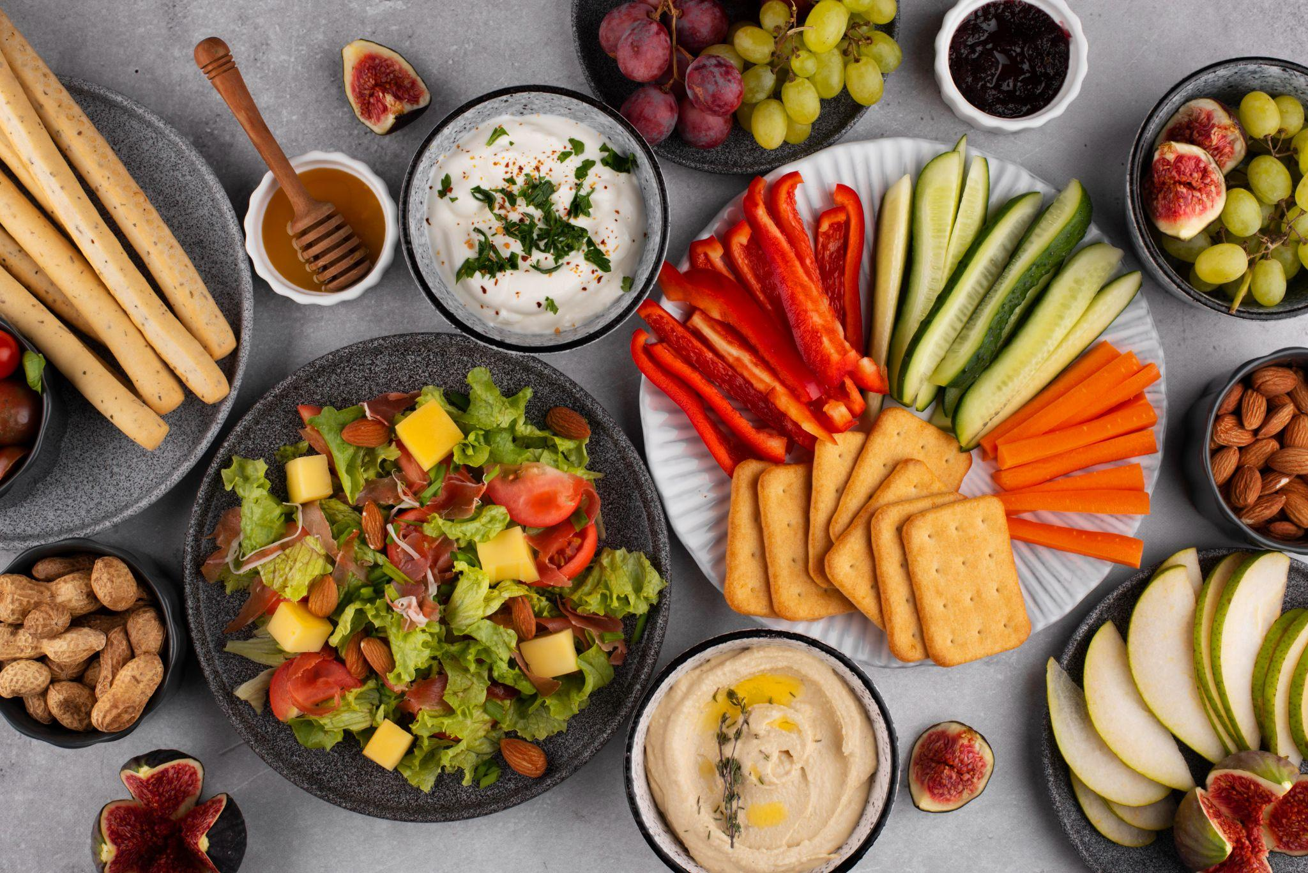
Thanks!
Do you have any questions?

Slide 22
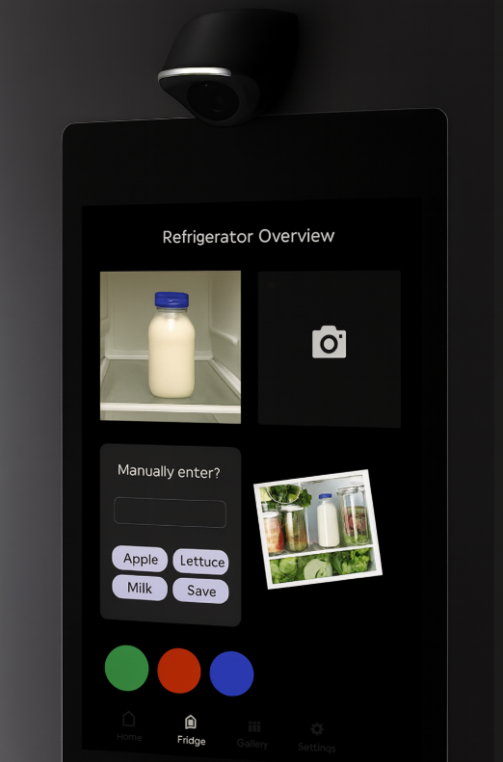
Automatic Categorization & Shelf-Life Estimation:
Identifies the type of food (fruit, dairy, vegetables, etc.)
Estimates shelf life based on food category
Adjusts expiration tracking using stored data

Slide 23
Image Classification Program:
Processes images captured by the camera
Recognizes food items using a trained classification model
Sends identified results to the database

Slide 24
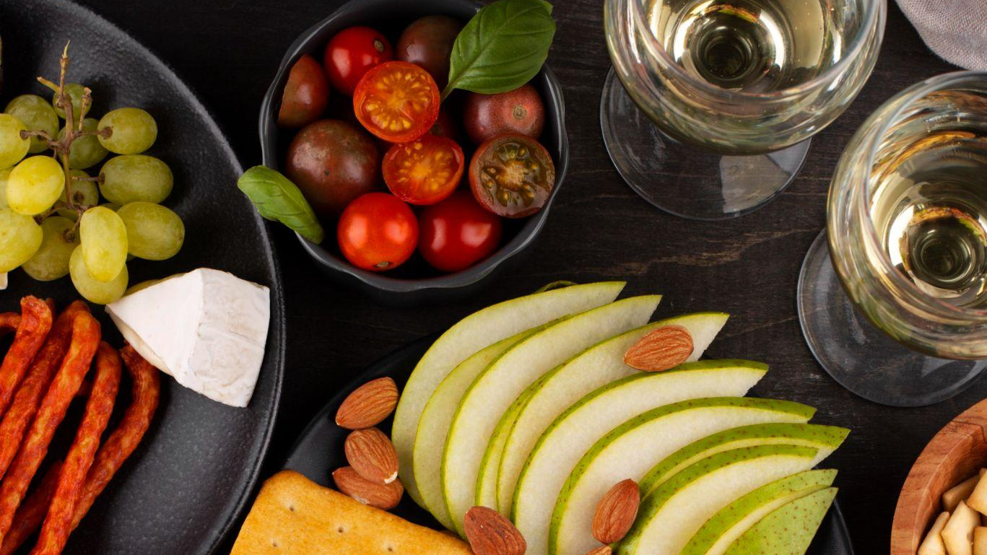
Gemini LLM:
Analyzes the available food items in the fridge
Generates recipe suggestions and usage ideas

Slide 25
Communication with Gemini:
Sends food data to Gemini through an API
Receives AI-generated responses
Displays suggestions directly on the fridge screen

Slide 26
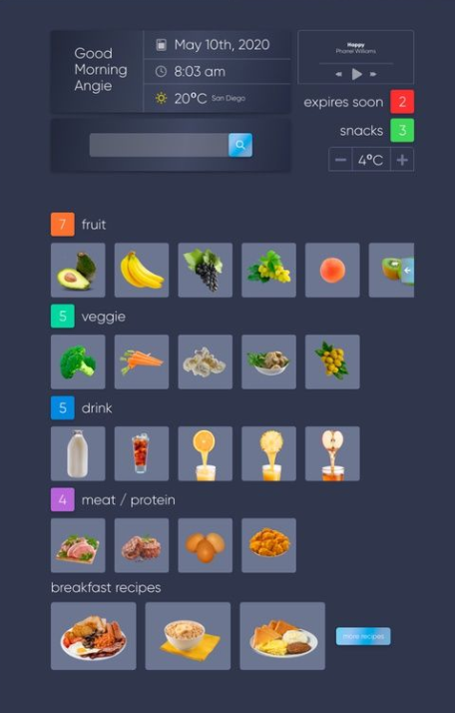
Future Add-ons:
Track user preferences and disliked foods to personalize recommendations
Enable multiple user profiles for shared households
Develop a mobile application to access the system remotely

Slide 27
Conclusion:
This project presents a smart fridge system that helps users manage food more efficiently using image recognition and AI.
By tracking food items and expiration dates, the system reduces food waste and promotes sustainable consumption.
AI-based recipe suggestions help users make better use of available ingredients and simplify meal planning.
The system is designed to be user-friendly and accessible to non-technical users through a touchscreen interface.
Future extensions such as personalized preferences, multi-user profiles, and a mobile application make the solution scalable and adaptable.
Overall, this project demonstrates how embedded systems and AI can be combined to address real-world sustainability challenges.

Slide 28
How it Work: Food Addition:
The user adds food items either by typing their name on the touchscreen or by taking a picture using the built-in camera.
The system records the item and its expiration date automatically.

Slide 29
How it Work: Viewing Stored Food:
All stored food items are displayed on the screen in a simple and organized list.
The user can easily see what is available and check upcoming expiration dates.

Slide 30
How it Work: Food Consumption:
When food is used, the user can remove or update the item with a single tap.
This keeps the food inventory accurate and up to date at all times.

Slide 31
How it Work:
Recipe Suggestions:
The system analyzes the available food items in the fridge.
An AI assistant suggests recipes based on what is currently available, helping reduce food waste.

Slide 32
Future additions
Track user preference (likes and dislikes)
Track multiple users in shared households
Make a phone application to track what is in the fridge remotely
Add grocery list suggestion (food only)
Add a database section for items available in the pantry

